Slide 1
Topic: Measurement EQ: How do I calculate the area of triangles?
Year 11 Essentials

Slide 2
Things Required For This Lesson
Interactive Notebook
Textbook: Interleaved Maths Essential Connections
Ruler, Red Pen, Pencil, Pens, Scientific Calculator
Growth mindset

Slide 3
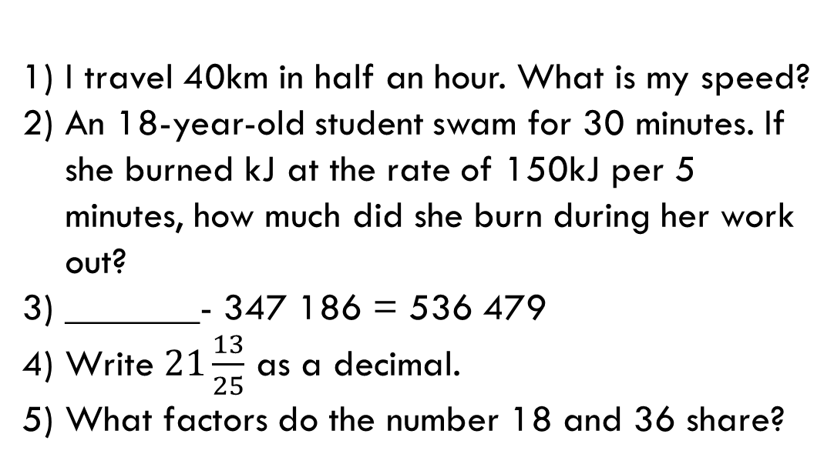
First 5
Answers
1) 80km/hr
2) 900kJ
3) 883 665
4) 21.52
5) 1, 2, 3, 6, 9, 18
I travel 40km in half an hour. What is my speed?
An 18-year-old student swam for 30 minutes. If she burned kJ at the rate of 150kJ per 5 minutes, how much did she burn during her work out?
_______- 347 186 = 536 479
Write $21\frac{13}{25}$ as a decimal.
What factors do the number 18 and 36 share?

Slide 4
24
7
30
Topic: Measurement
EQ: How do I calculate the area of triangles?
Experiment – page 67
Take any rectangle. Identify any point along the top of the rectangle and use this point as the apex for the triangle.
Join the apex to the corners of the base using a ruler.
Cut your main triangle.
Join the two smaller, left-over triangles to form another triangle.
What do you notice about the size of your main triangle compared with the triangle made from the 2 parts?
How can you adapt the base x height rectangle or length x width formula to solve the are of triangles?
WICOR

Slide 5
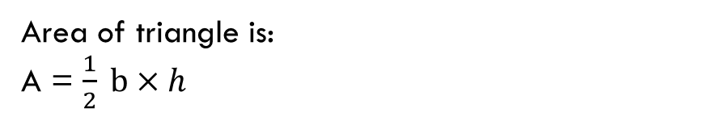
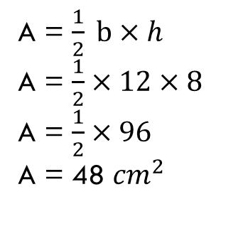
24
7
30
Topic: Measurement
EQ: How do I calculate the area of triangles?
How do I solve the area of a triangle?
Area of triangle is:
A = $\frac{1}{2} b×h$
How do I apply the formula for area of a triangle?
8 cm
12 cm
A = $\frac{1}{2} b×h$
A = $\frac{1}{2}×12×8$
A = $\frac{1}{2}×96$
A = 48 ${cm}^{2}$
WICOR

Slide 6
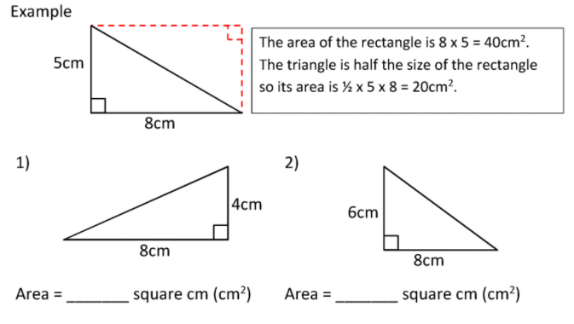
24
7
30
Topic: Measurement
EQ: How do I calculate the area of triangles?
Practice:
3. Practice on page 67
Qs 3, 4, 5
WICOR

Slide 7
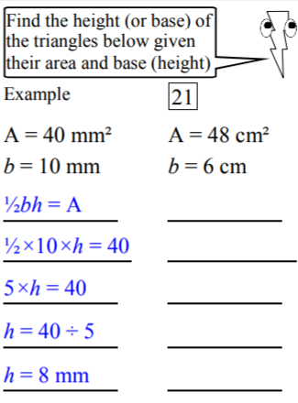
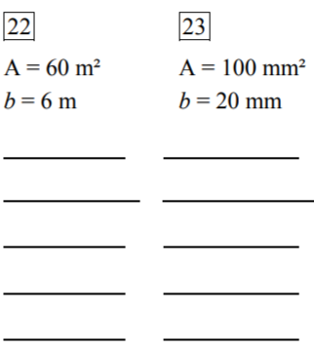
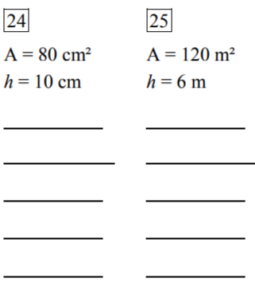
Complete the area of triangle worksheet
Finished? Have a go at these:

Slide 8

Thank you
Keep up the good work!

